Slide 1
Water Quality Testing In Microsoft Fibric

Slide 2
What is Microsoft Fibric. What is water quality testing? Activity Perform In Flow Water Quality Dataset In Feature Dataset Limitations Algorithm Power BI Report

Slide 3
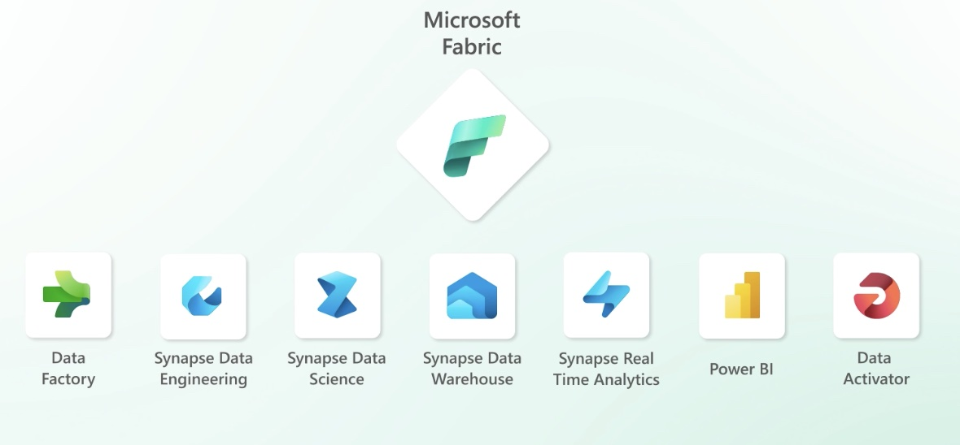
What is Microsoft Fibric.
Microsoft Fabric is an end-to-end analytics solution with full-service capabilities including data movement, data lakes, data engineering, data integration, data science, real-time analytics, and business intelligence—all backed by a shared platform providing robust data security, governance, and compliance.

Slide 4
What is water quality testing?
Water quality tests will give information about the health of the waterway. By testing water over a period of time , the changes in the quality of the water can be seen. Parameters that may be tested include temperature, pH (potential of Hydrogen), turbidity, Dissolved Oxygen (DO)and Conductivity.

Slide 5
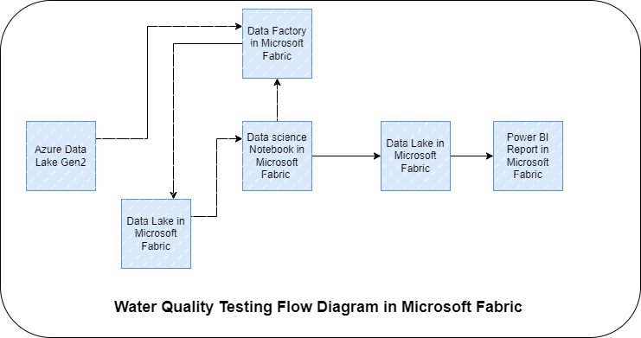
Activity Perform In Flow

Slide 6
Water Quality Dataset In Feature
pH: pH measures the acidity or basicity of a liquid on a scale from 0 to 14. Values less than 7 indicate acidic conditions, values greater than 7 suggest primary needs and a value of 7 indicates a neutral state.
Dissolved Oxygen (DO): DO measures the amount of oxygen dissolved in water and is essential for aquatic life. High DO levels are crucial for the survival of fish and other marine organisms.
Temperature: Temperature affects various physical, chemical, and biological processes in water bodies. It is an essential factor that influences the rate of many aquatic processes.

Slide 7
Dataset Limitations
Biochemical Oxygen Demand (BOD): BOD measures the amount of oxygen microorganisms require to decompose organic matter in water. High BOD levels can indicate that the water is polluted with organic matter and may not be suitable for consumption or recreation.
Total Suspended Solids (TSS): TSS measures the amount of solids suspended in water, including organic matter, sediment, and other pollutants. High TSS levels can indicate poor water quality and affect aquatic life and other uses of water.
Nitrate-Nitrogen (NO3-N): NO3-N measures the amount of nitrate in water. Nitrate is an essential nutrient for plant growth, but high nitrate levels in drinking water can harm human health.
Conductivity : Conductivity of water

Slide 8
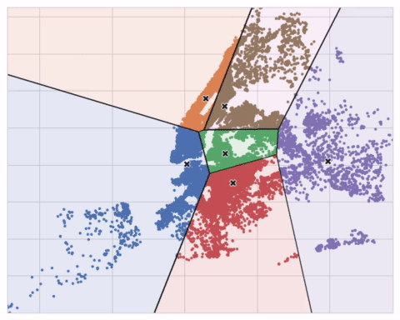
Algorithm
K-means clustering is a popular unsupervised machine learning algorithm used for clustering data points into groups based on their similarity. It aims to partition the data into K clusters, where each data point belongs to the cluster with the nearest mean value. Here's how the algorithm works:
Choose the number of clusters, K, that you want to identify.

Slide 9
Power BI Report
Power BI is a business intelligence tool developed by Microsoft that allows users to create interactive visualizations and reports from various data sources. A Power BI report is a collection of these visualizations, tables, and other data representations that provide insights into the underlying data.
Visualizations
Pages
Filters and Slicers
Data Model
Interactivity
Sharing and Collaboration

Slide 10
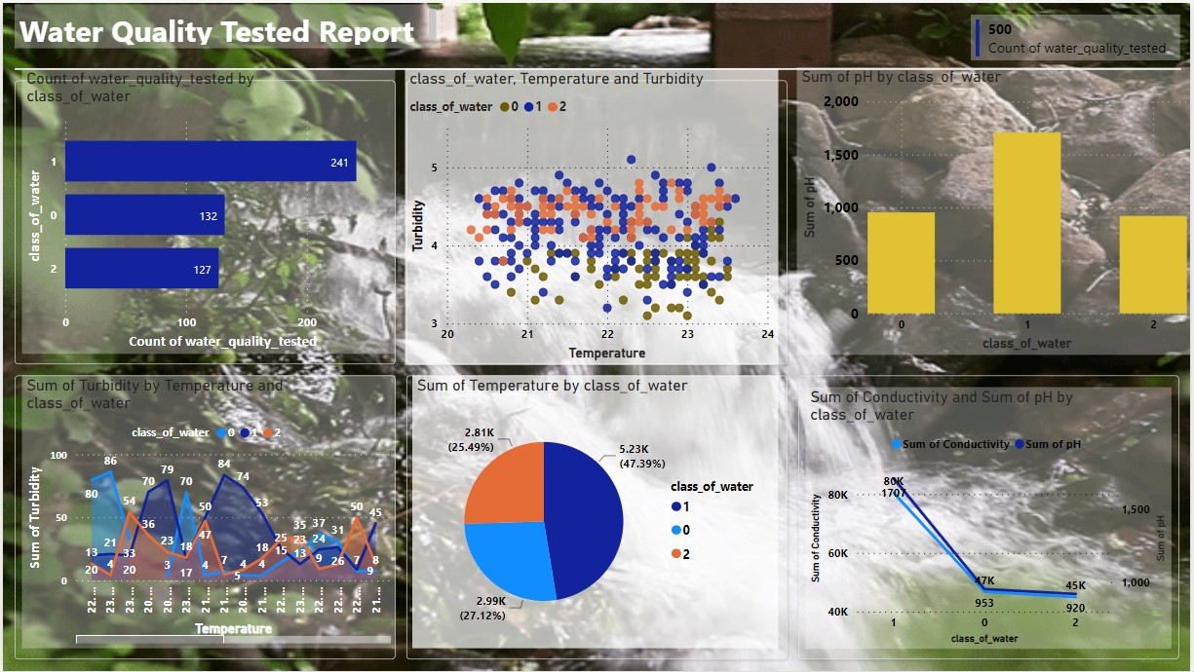
Power BI Report

Slide 11
Thank You!

